Slide 1
Patterns of Enterprise DevOps Adoption
Cameron Haight Research Vice President @cameron_haight
Notes:
Presentation Title
Presenter's Name
Presenter's Name

Slide 2
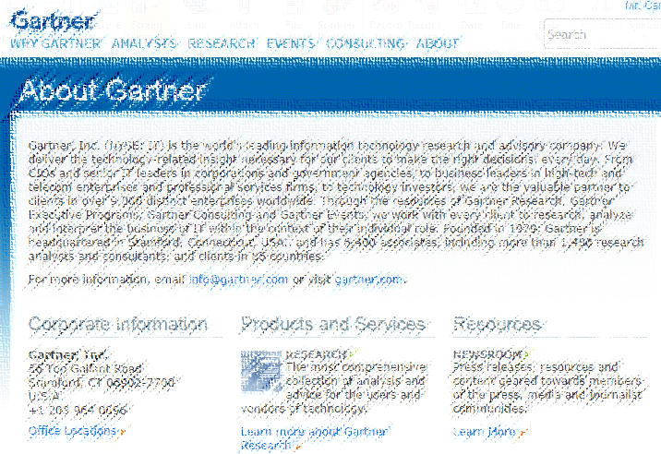
Who Is Gartner?
Founded in 1979, Gartner, Inc. (NYSE: IT) recorded 2013 revenues of $1.784 billion
Last year, 980 analysts engaged in over 210,000 one-to-one client interactions
We have clients in 9,000 distinct enterprises located within 85 countries
72% of the Fortune 1000 and 75% of the Global 500 support their key technology decisions with Gartner advice
Each year on Gartner.com we see 4 million end-user searches and 5 million end-user document page views

Slide 3
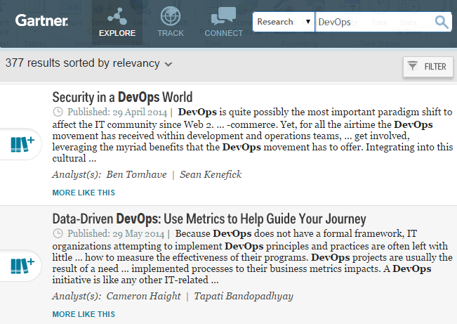
Gartner.com: DevOps Is the Top IT Operations Management Search Term

Slide 4
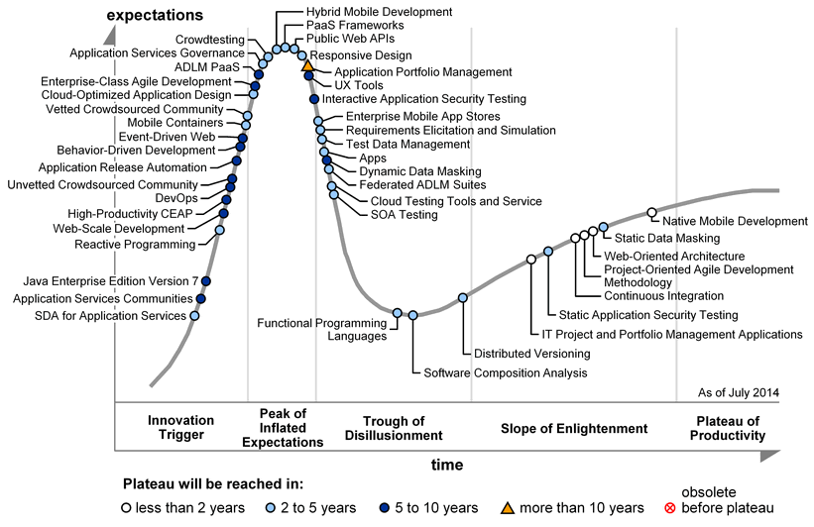
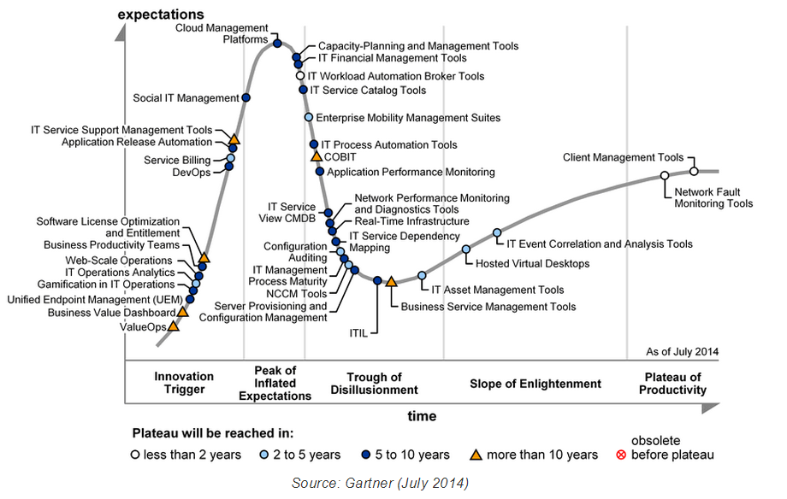
Where Gartner Sees DevOps in the Adoption Lifecycle
Development
Operations

Slide 5

Even With Adoption Increasing, Our Clients Often Show Different Personalities
I’m skeptical!
I’m psyched!
Source: https://www.flickr.com/photos/sonofgroucho/3154732628

Slide 6

What’s the Biggest Corporate Impediment?
Source: Gartner Research (n=55); https://www.flickr.com/photos/newmundane/8581629776

Slide 7

Other Continuing Challenges in Adoption: Lack of a Blueprint
How do I know if I’m doing DevOps?
Source: https://www.flickr.com/photos/wscullin/3770015203

Slide 8
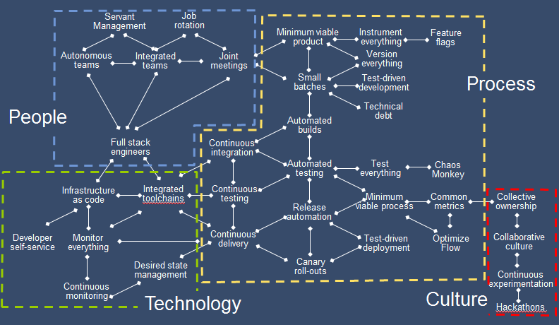
DevOps Patterns and Practices: A Gartner Perspective

Slide 9

And Compliance and Regulatory Issues Often Still Loom Large
We’re a bank and not Facebook!
Source: https://www.flickr.com/photos/wscullin/3770015203

Slide 10

Also Need Constant Vigilance Re: Vendor Claims

Slide 11
What “Parts” of DevOps Are Experiencing the Most Uptake?
Source: Gartner Research (n=56)

Slide 12
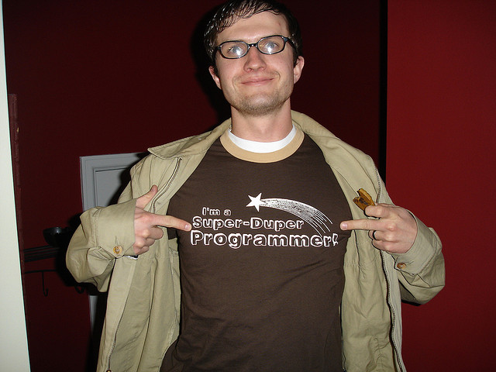
There is Also Increasing Interest in Full Stack Engineers/2 Pizza Teams
Source: https://www.flickr.com/photos/deltamike/112665732

Slide 13
Metrics That We Are Observing That Clients Use to Measure DevOps
Earnings
Cash Flow
Business Performance
Market Share
New business services enablement
Lead Time
User Satisfaction
Epics Delivered
Customer Value
Response Time
Releases per Month
Net Promoter Score
Retention
Mentoring
Motivation / Morale
Organizational Effectiveness
Sharing
Responsiveness to Change
Collaboration
Service Quality
Service Velocity
MTTRS
Production Support
Cycle Time
Deployment Success Rate
Deployment Frequency
Cost per Transaction
Operational Efficiency
Users/FTE
Cost of Change/Release
Servers/FTE
Source: Gartner

Slide 14
Where Are Enterprises Focusing Their Initial DevOps Efforts?
DevOps
+
Systems of Innovation
-
Systems of Differentiation
Change
Governance
Systems of Record
-
+
Traditional
Notes:
As part of the Pace Layered Application Strategy™, Gartner has defined three application categories or "layers" to distinguish these application types and to help organizations such as the IT operations team to develop more appropriate strategies for their support. These categories are described as: Systems of Record — established packaged applications or legacy homegrown systems that support core transaction processing and manage the organization's critical master data, such as the general ledger, are found here. Systems of Differentiation — consists of applications that enable unique company processes or industry specific capabilities. The business processes they support have a medium life cycle (one to three years), but need to be reconfigured more frequently to accommodate changing business practices or customer demands. Systems of Innovation — new applications that are built on an ad hoc basis often without full knowledge of needed requirements (and where the software is the documentation) to address new business opportunities. These are typically short life cycle projects (zero to 12 months) using departmental or outside resources and consumer-grade technologies. DevOps-oriented operational processes are most likely to be found in support of Systems of Innovation as the need to match the velocity of the development life cycle is usually most critical here.

Slide 15
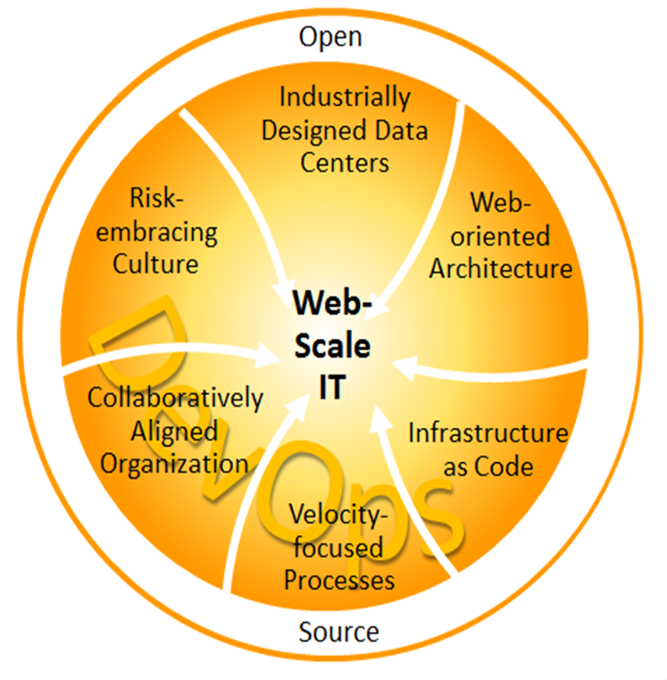
What We Tell Clients Today: DevOps is Necessary But Not Sufficient

Slide 16

Summary: There Is No Going Backwards
Source: http://www.incwell.com/Biographies/Caesar.html

Slide 17













And On a Personal Note: Thanks to the DevOps Pioneers!

Slide 18
Recommended Gartner Research
Use Web-Scale IT to Make the Enterprise IT Competitive With the Cloud Cameron Haight (http://www.gartner.com/document/2485716)
Seven Steps to Start Your DevOps Initiative Ronni Colville (http://www.gartner.com/document/2847717)
Data-Driven DevOps: Use Metrics to Help Guide Your Journey Cameron Haight (http://www.gartner.com/document/2753718)
When Using DevOps Principles, Follow Six Gartner Rules to Minimize Compliance and Audit Findings George Spafford, Cameron Haight (http://www.gartner.com/document/2666523)
Cool Vendors in DevOps, 2014 Ronni Colville, et. al. (http://www.gartner.com/document/2711522)
IPC's Experience Affirms Operational Benefits of Kanban Cameron Haight (http://www.gartner.com/document/2130615)
For more information, stop by Gartner Research Zone.

Slide 19
Where Can We Use Assistance?
Additional case studies especially those in “legacy” environments

Slide 20
Patterns of Enterprise DevOps Adoption
Cameron Haight Research Vice President @cameron_haight
Notes:
Presentation Title
Presenter's Name
Presenter's Name

